Slide 1
Conjugate gradient method
Supervisor: Professor Soleimani
Producer : Hassan Ardeshir

Slide 2
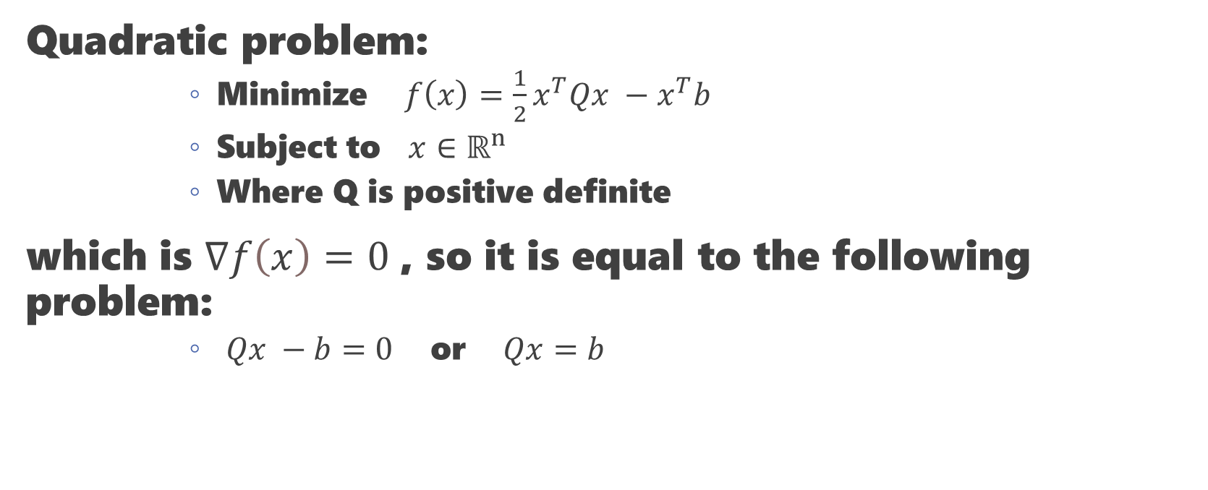
Conjugate Direction Methods
Quadratic problem:
Minimize $f\left(x\right)=\frac{1}{2}x^{T}Qx −x^{T}b$
Subject to $x∈ℝ^{n}$
Where Q is positive definite
which is $∇f\left(x\right)=0$, so it is equal to the following problem:
$Qx −b=0$ or $Qx=b$

Slide 3
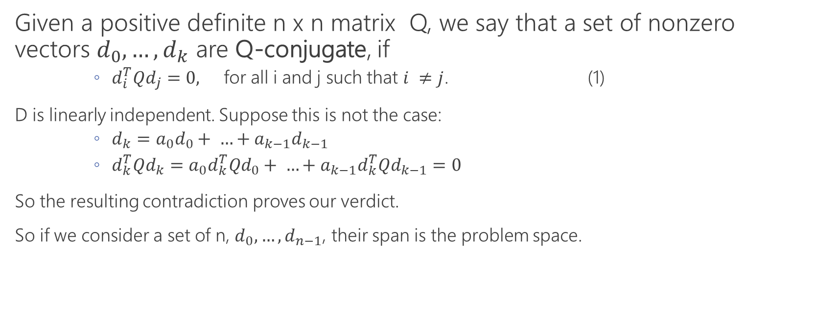
Q-Conjugate
Given a positive definite n x n matrix Q, we say that a set of nonzero vectors $d_{0},…, d_{k}$ are Q-conjugate, if
$d_{i}^{T}Qd_{j}=0,$ for all i and j such that $i ≠j$. (1)
D is linearly independent. Suppose this is not the case:
$d_{k}=a_{0}d_{0}+ …+a_{k−1}d_{k−1}$
${d_{k}^{T}Qd}_{k}=a_{0}d_{k}^{T}{Qd}_{0}+ …+a_{k−1}{d_{k}^{T}Qd}_{k−1}=0$
So the resulting contradiction proves our verdict.
So if we consider a set of n, $d_{0},…,d_{n−1}$, their span is the problem space.

Slide 4

Conjugate Direction Methods
Minimization of the quadratic function
$f\left(x\right)=\frac{1}{2}x^{T}Qx −b^{T}x$
For every $k=0, …, n−1$ :
$x_{k+1}=x_{k}+a_{k}d_{k}$
Where $x_{0}$ is an arbitrary starting vector and $a_{k}$ is obtained by the line minimization rule:
$f\left(x_{k}+a_{k}d_{k}\right)= \min_{a}{f(x_{k}+ad_{k})}.$
So: $0= \frac{∂f(x_{k}+a_{k}d_{k})}{∂a}=d_{k}^{T}∇f\left(x_{k}+a_{k}d_{k}\right)=d_{k}^{T}(Q\left(x_{k}+a_{k}d_{k}\right)−b)$
So: $a_{k}=\frac{d_{k}^{T}\left(b−Qx_{k}\right)}{d_{k}^{T}Qd_{k}}$

Slide 5

Conjugate Direction Methods
$$x_{k+1}=\arg{\min_{x∈M_{k}}{f(x)}}$$
Where
$$M_{k}=\left\{x\right|x=x_{0}+v, v∈(subspace spanned by d_{0},…, d_{k})\}$$
$$=x_{0}+\left(subspace spanned by d_{0}, …, d_{k}\right).$$
So $x_{n}$ minimizes f over $ℝ^{n}$.

Slide 6
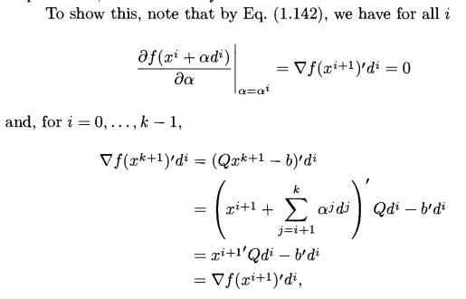
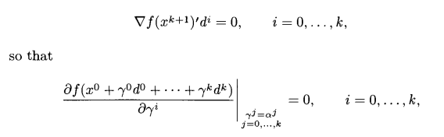
Conjugate Direction Methods
Proof:

Slide 7
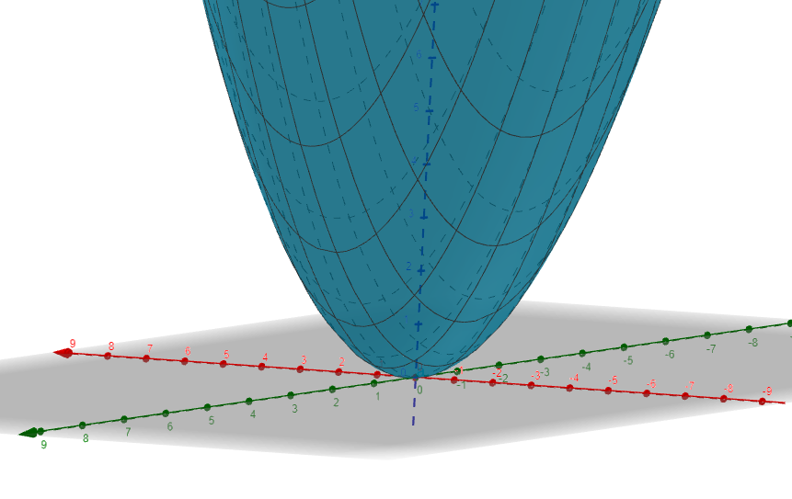

Convex Problem
$$f\left(x\right)=\frac{1}{3}x^{2}+\frac{1}{3}y^{2}+\frac{1}{5}xy$$

Slide 8
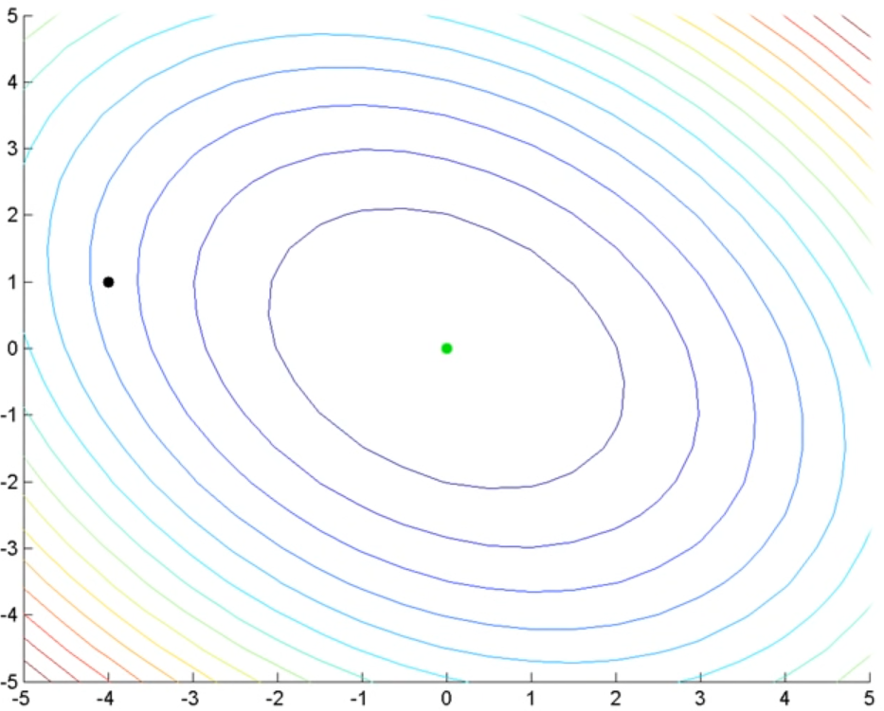
Gradient descent

Slide 9
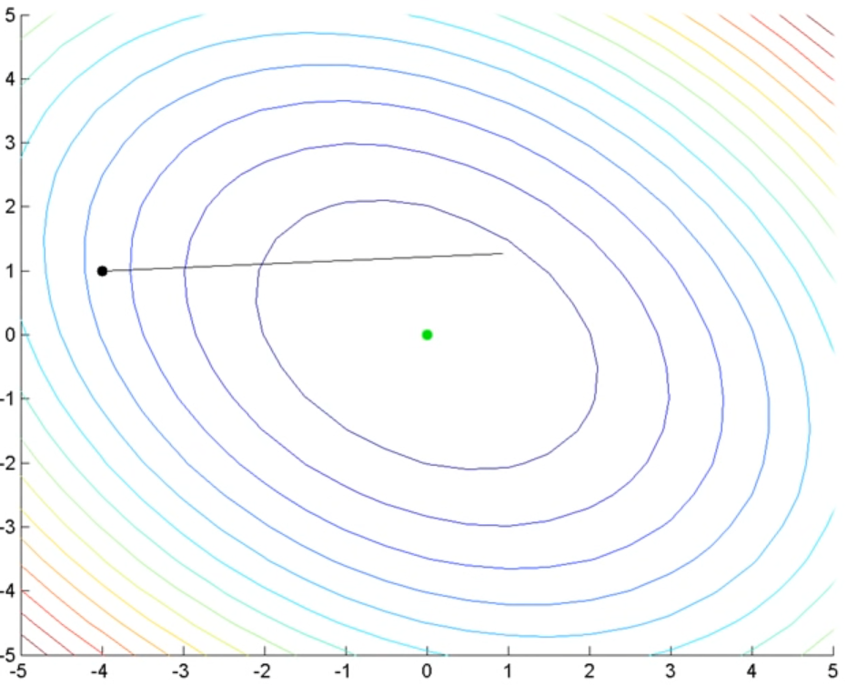
Gradient descent

Slide 10
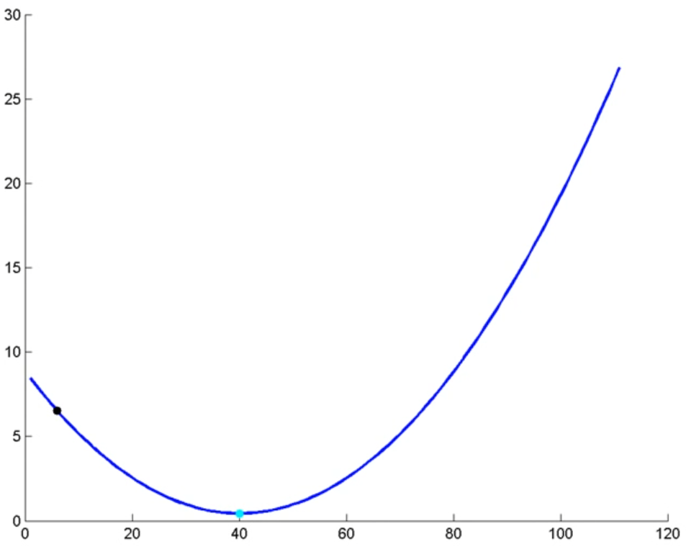
Gradient descent

Slide 11
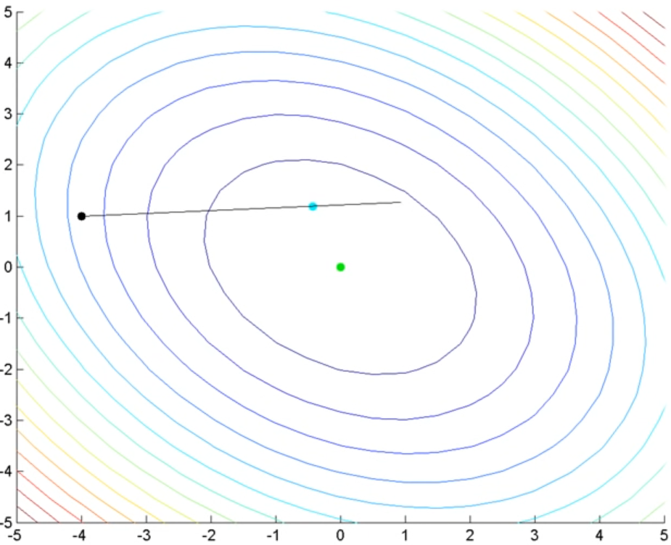
Gradient descent

Slide 12
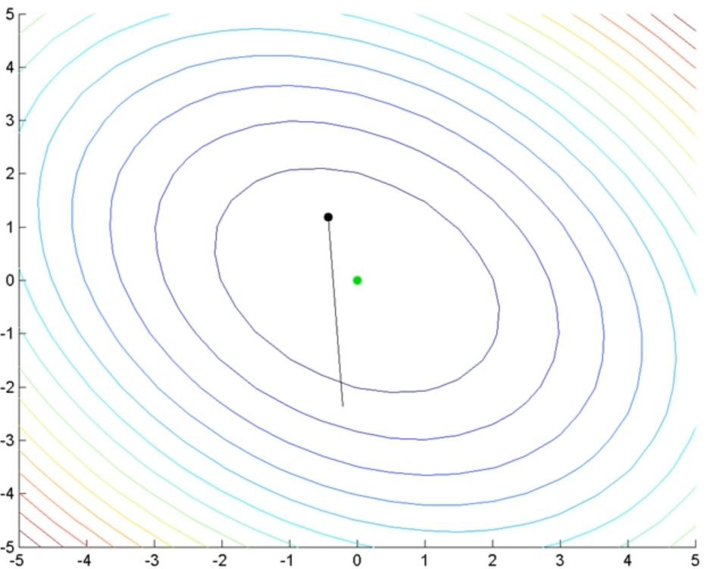
Gradient descent

Slide 13
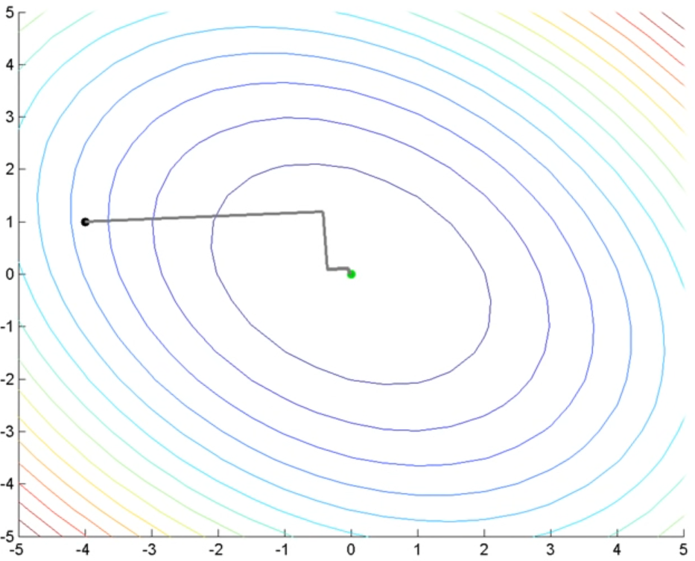
Gradient descent

Slide 14
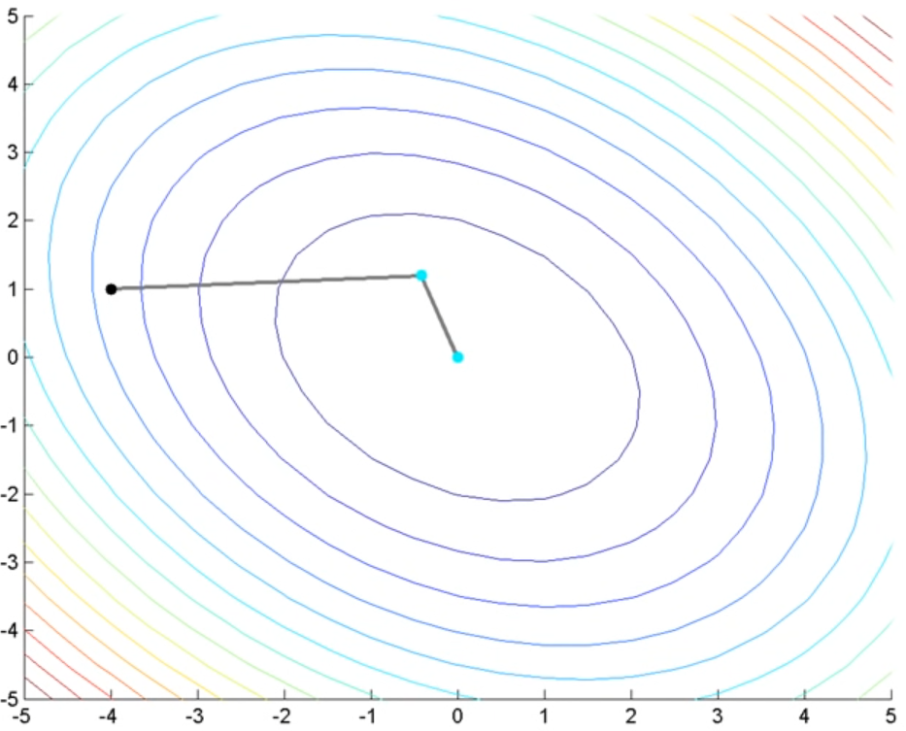
Conjugate Gradient Method

Slide 15

Conjugate Gradient Method
Q is the Hessian of f:
$$f\left(x\right)=\frac{1}{3}x^{2}+\frac{1}{3}y^{2}+\frac{1}{5}xy=\frac{1}{2}x^{T}Qx −x^{T}b$$
$$Q= \left[\begin{matrix}\frac{2}{3} & \frac{1}{5} \\ \frac{1}{5} & \frac{2}{3}\end{matrix}\right]and b=\left[\begin{aligned}0 \\ 0\end{aligned}\right]$$
Minimize f $Qx = b$

Slide 16

Conjugate Gradient Method
Let $\{d_{0},…, d_{n−1}\}$ be n Q-Conjugate vectors
Let x* be the minimum of f(x)
$x^{∗}= \sum_{i=0}^{n−1}{a_{i}d_{i}} → Qx^{∗}=\sum_{i=0}^{n−1}{a_{i}{Qd}_{i}}$ = b
$$d_{k}^{T}b= \sum_{i=0}^{n−1}{a_{i}{d_{k}^{T}Qd}_{i}} → d_{k}^{T}b=a_{k}d_{k}^{T}Qd_{k}$$
$$a_{k}=\frac{d_{k}^{T}b}{d_{k}^{T}Qd_{k}}$$

Slide 17

Conjugate Gradient Method
$d_{0}=−g_{0}=b−Qx_{0},$
$d_{k}=−g_{k}+β_{k}d_{k−1}, k=1,…,n−1,$
$β_{k}=\frac{g_{k}^{T}g_{k}}{g_{k−1}^{T}g_{k−1}}.$
$d_{1}=−g_{1}+β_{1}d_{0} = −g_{1}−β_{1}g_{0}$
$d_{2}=−g_{2}+β_{2}d_{1} = −g_{2}−β_{2}g_{1}−{β_{2}β}_{1}g_{0}$
$d_{k}=−g_{k}−t_{k}g_{k−1}−…−t_{1}g_{0}$

Slide 18
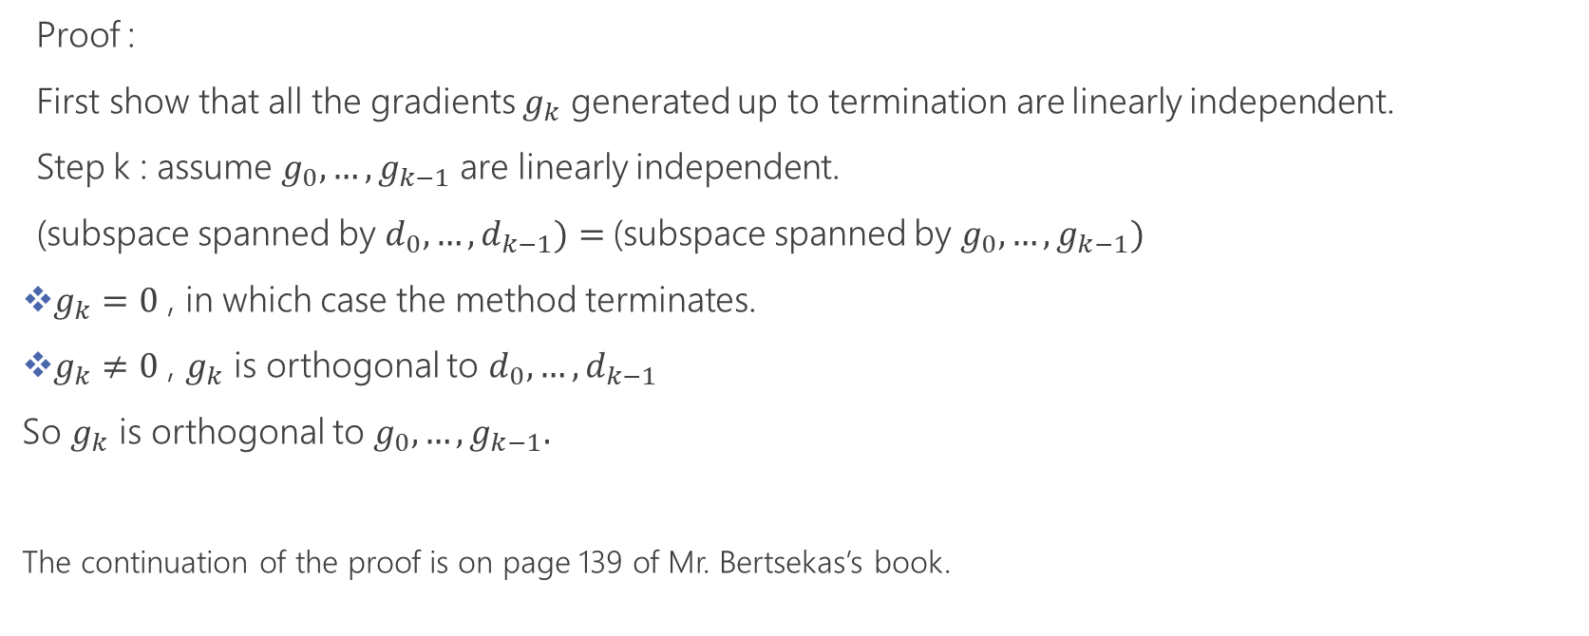
Conjugate Gradient Method
Proof :
First show that all the gradients $g_{k}$ generated up to termination are linearly independent.
Step k : assume $g_{0},…,g_{k−1}$ are linearly independent.
(subspace spanned by $d_{0},…,d_{k−1})=$(subspace spanned by $g_{0},…,g_{k−1})$
$g_{k}=0$ , in which case the method terminates.
$g_{k}≠0$ , $g_{k}$ is orthogonal to $d_{0},…,d_{k−1}$
So $g_{k}$ is orthogonal to $g_{0},…,g_{k−1}.$
The continuation of the proof is on page 139 of Mr. Bertsekas’s book.

Slide 19
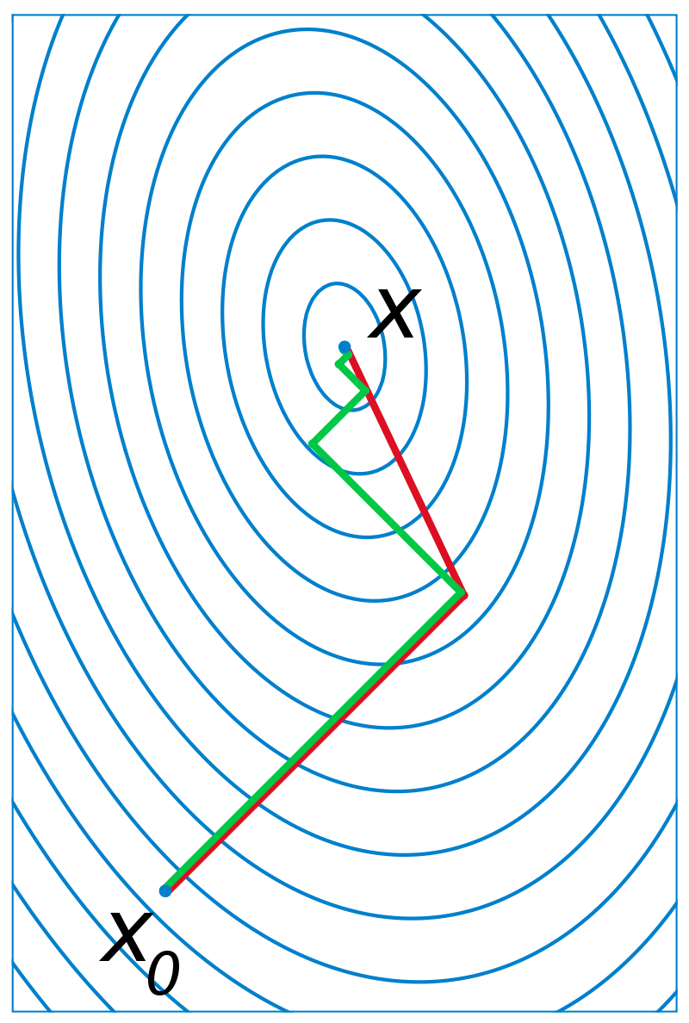
Conjugate Gradient Method

Slide 20
Reference
Nonlinear programming - Dimitri P. Bertsekas (1999)
Nonlinear Optimization - Andrzej Ruszczy ´nski (2006)

Slide 21


